Slide 1
LLNL Knowledge Subgraphs
Aubrey Moulton (Speaker), Brent Basiano, Mahsa Valizadeh, Bryant McArthur, Vandna Krishnan

Slide 2
Outline/Introduction
Introduction to the LLNL Project
Overview of Knowledge Graphs
User Stories:
Login
Include
Exclude
Budget
Challenges
Lessons

Slide 3
Overview of Knowledge Graphs

Slide 4
Knowledge Graphs

Slide 5
Login

Slide 6
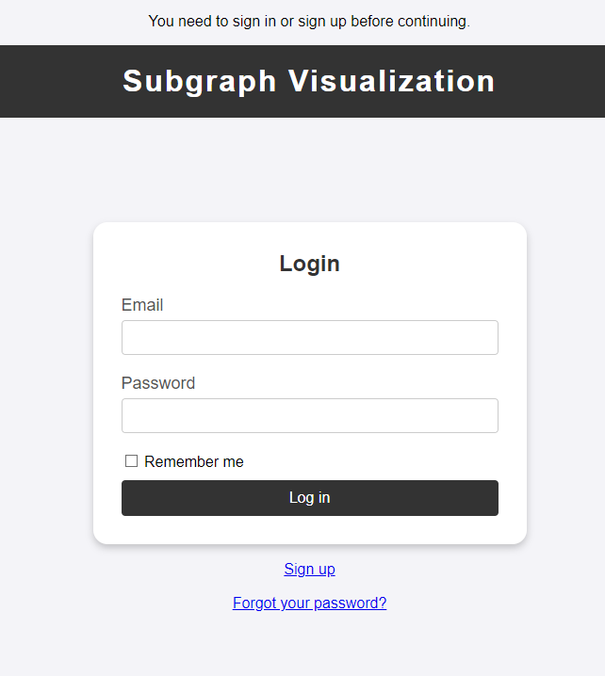
Login
Registration and Sign-in Process
Importance of User Registration
Access to Main Dashboard

Slide 7
Include

Slide 8
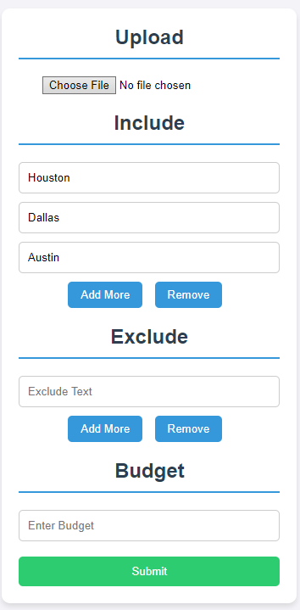
Include
Manually Adding Nodes to the Graph
Simplifying Node Addition for Users
Uploading Nodes via JSON File

Slide 9
Exclude

Slide 10
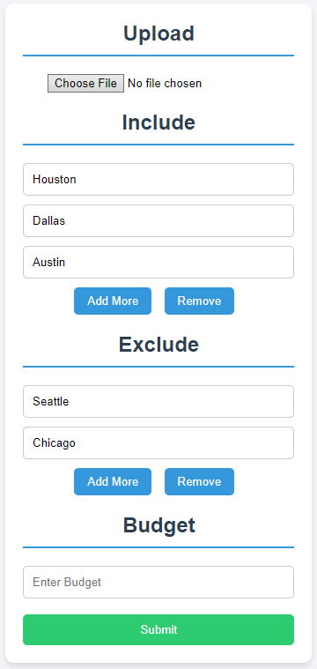
Exclude
Removing Unwanted Nodes
Dynamic User Interaction with the Graph
User Control over Graph Complexity

Slide 11
Budget

Slide 12
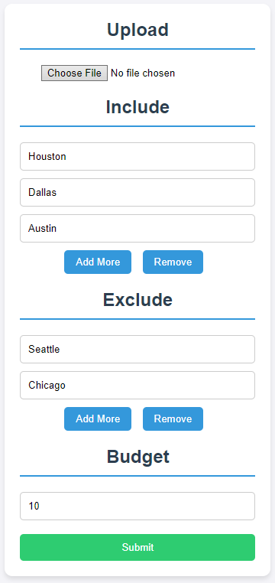
Budget
Setting Limits for Node Display
User-Defined Maximum Node Count
Balancing Graph Clarity and Information Density

Slide 13
Interactive Metadata

Slide 14
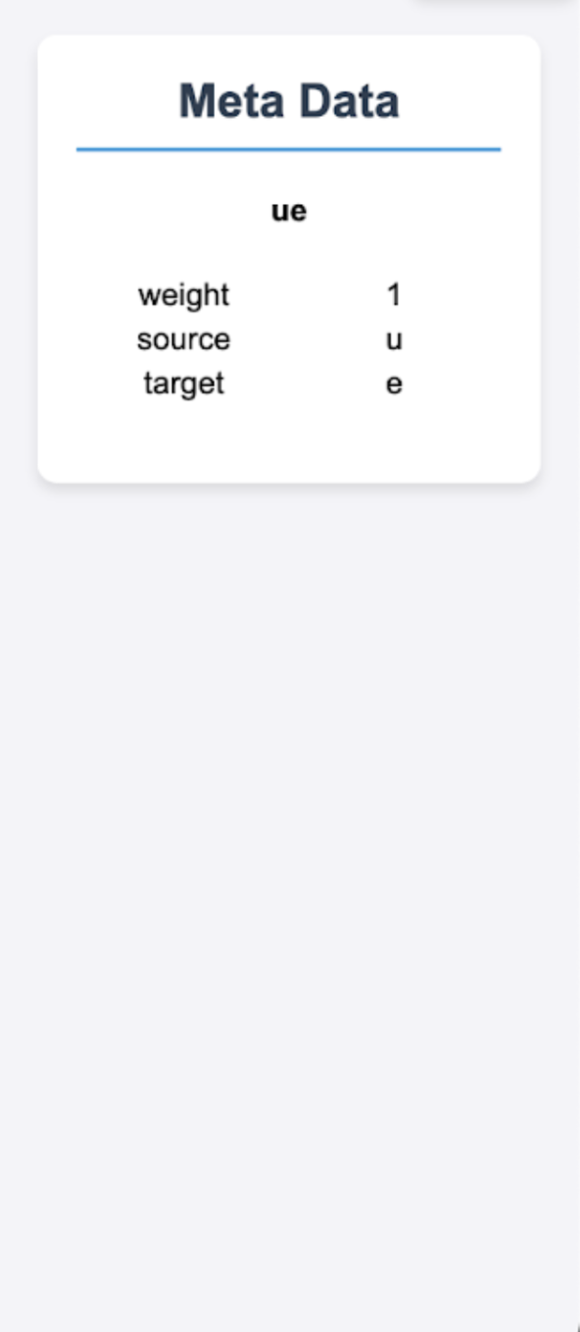

Interactive Metadata
Interactive Nodes
Include and Exclude while Exploring Graph

Slide 15
Challenges

Slide 16
Challenges
Integrating C++ Backend
Handling CMAKE in Ubuntu Environment
Deployment Challenges on Heroku

Slide 17
Lessons

Slide 18
Lessons
Insights on CMAKE Functionality
Experience Gained in Ruby Development
Effective Communication with Client

Slide 19
Thanks and Gig ‘Em

